Slide 1



OFFCAMPUS
Job portal
Take the first step toward your dream career. Join us today to discover opportunities that align with your goals and aspirations. Find the perfect job that empowers and benefits you. Your future starts here—take action now!

Slide 2


MEMBERS OF
Our Group
Rahul Samanta
University Roll: 14271023058

Slide 3

MEMBERS OF
Our Group
Anamika Nandi
University Roll: 14271023058

Slide 4

MEMBERS OF
Our Group
Abhigyan Sengupta
University Roll: 14271023058

Slide 5

TABLE OF
Contents
01
Introduction
02
About our Project
03
Software Used
04 -13
Our Website
14
Future Scope
15
Conclusion
07

Slide 6

Introduction
Our project, we have decided to proceed with ‘ OffCampus’ a job portal system. This application aims to provide users with a fast and easy-to-use platform to explore and select their dream companies, guiding them toward a better future.
Additionally, it focuses on highlighting companies that prioritize employee health and offer comprehensive benefits. The system will include advanced search filters, personalized recommendations, and seamless application tracking, ensuring an efficient job search experience. With a user-centric approach, it aims to bridge the gap between top companies and talented individuals, fostering professional growth and satisfaction.
OffCampus
Page 01 of 22

Slide 7

ABOUT OUR
Our project is about a job portal System named Off-Campus, designed to streamline the job search and recruitment process. It offers users a fast, intuitive platform to discover job opportunities, connect with companies, and select positions that align with their career aspirations. The portal emphasizes user-friendly navigation, advanced search capabilities, and tailored recommendations to enhance the job-seeking experience.
Project
STRENGTHS
Attractive Animations
Intricate Desings
Fast and Simple Use
WEAKNESSES
Dependence on Internet Speed and system configuration
Limited Offline Functionality
Limited Initial Data
OffCampus
Page 02 of 22

Slide 8


Software Used
MongoDB
React+Vite
Express
Google Studio
ShadCn Ui
Gemini
Node Js
Vs Code
cloudinary
OffCampus
Page 03 of 22

Slide 9
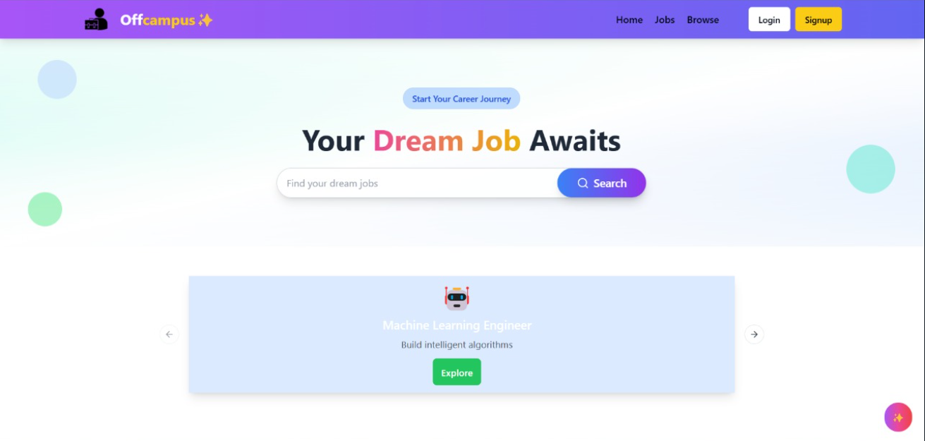
HOME PAGE
OffCampus
Page 04 of 22

Slide 10
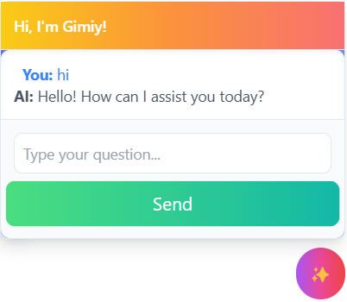
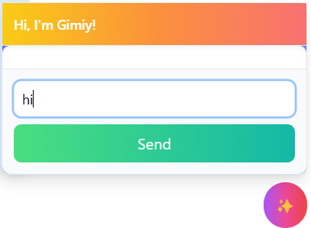
AI CHATBOT - GIMIY!
Interact with our chatbot GIMIY!
OffCampus
Page 05 of 22

Slide 11
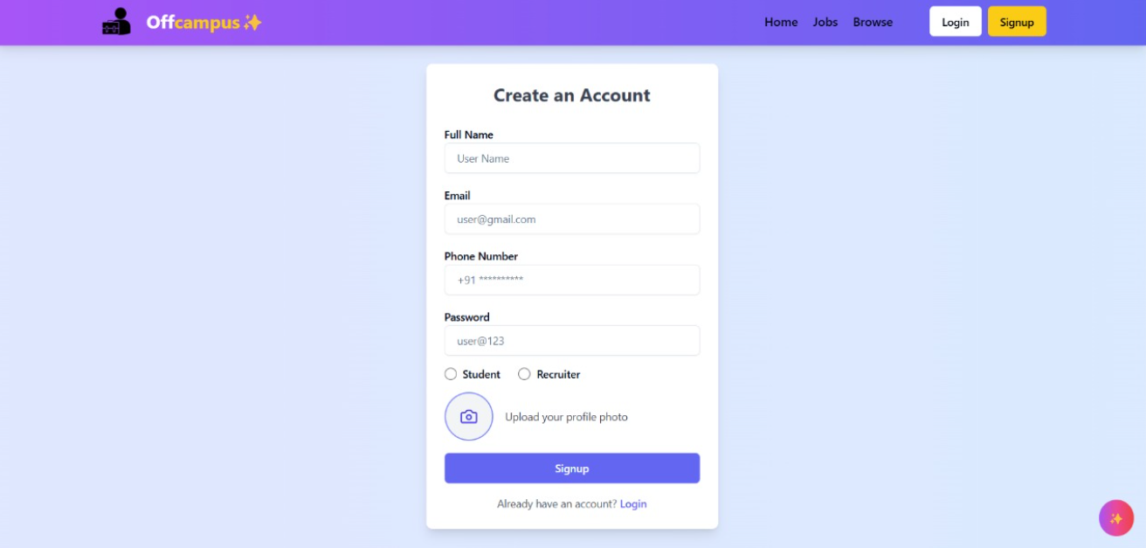
REGISTRATION PAGE
Fill your details and sign up on Offcampus!
OffCampus
Page 06 of 22

Slide 12
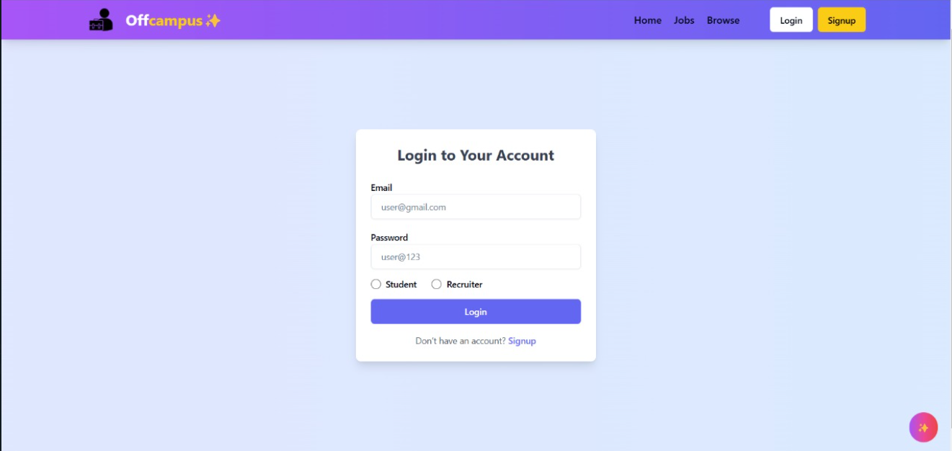
LOGIN PAGE
Login as Student or Recruiter
OffCampus
Page 07 of 22

Slide 13
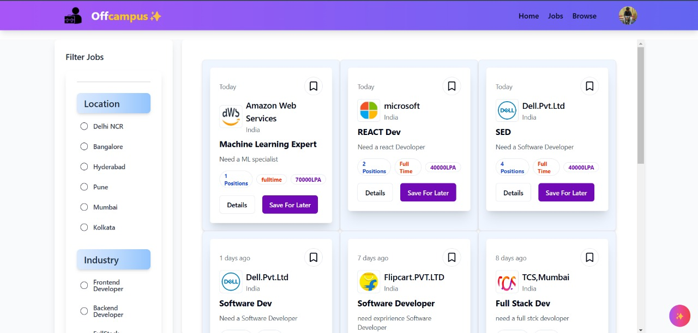
JOB PAGE
Find your job as per your choice
OffCampus
Page 08 of 22

Slide 14
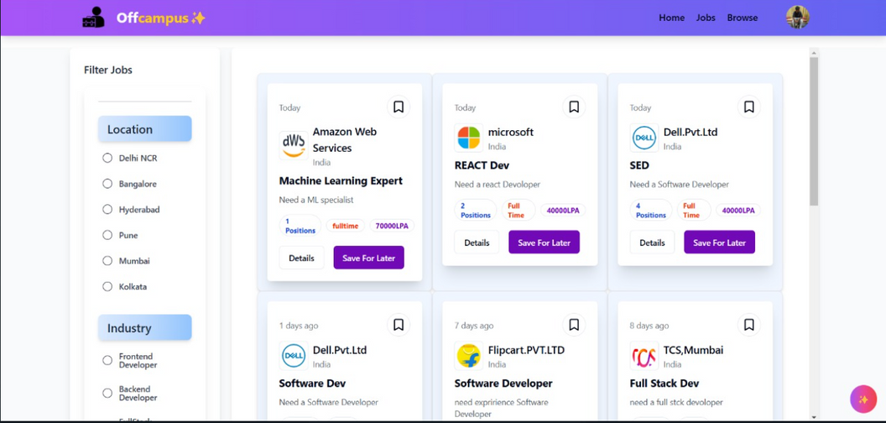
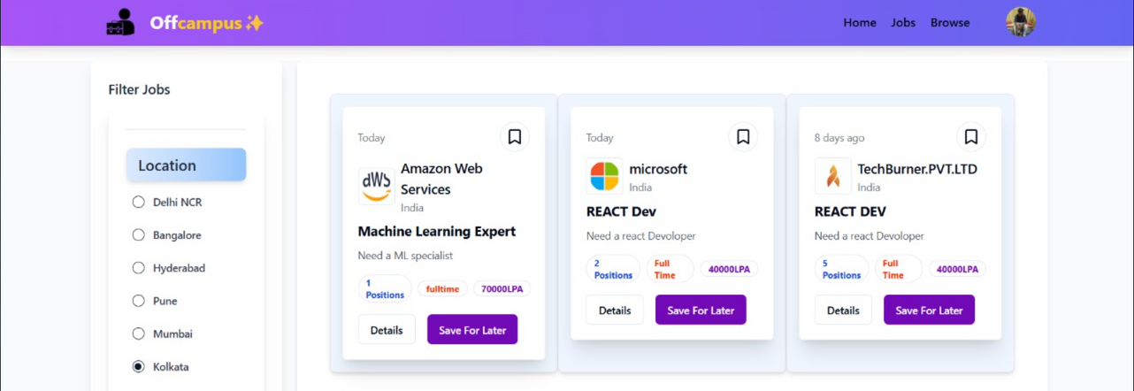
JOB SEARCH PAGE
Job Search without filter
Job Search with filter
OffCampus
Page 09 of 22

Slide 15
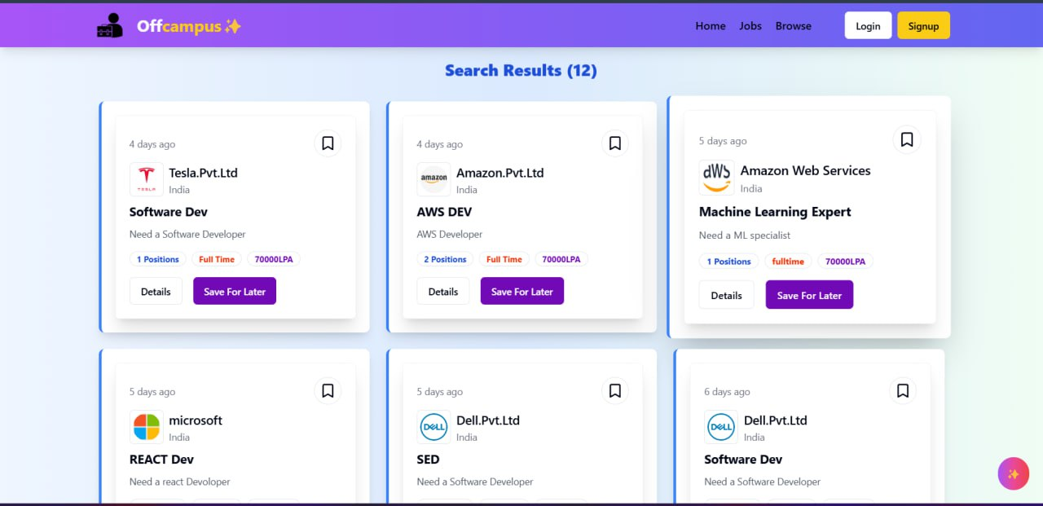
BROWSE PAGE
The future of browsing pages involves AI personalization, Progressive Web Apps, IoT integration, voice search optimization, and responsive, user-centric designs.
OffCampus
Page 10 of 22

Slide 16
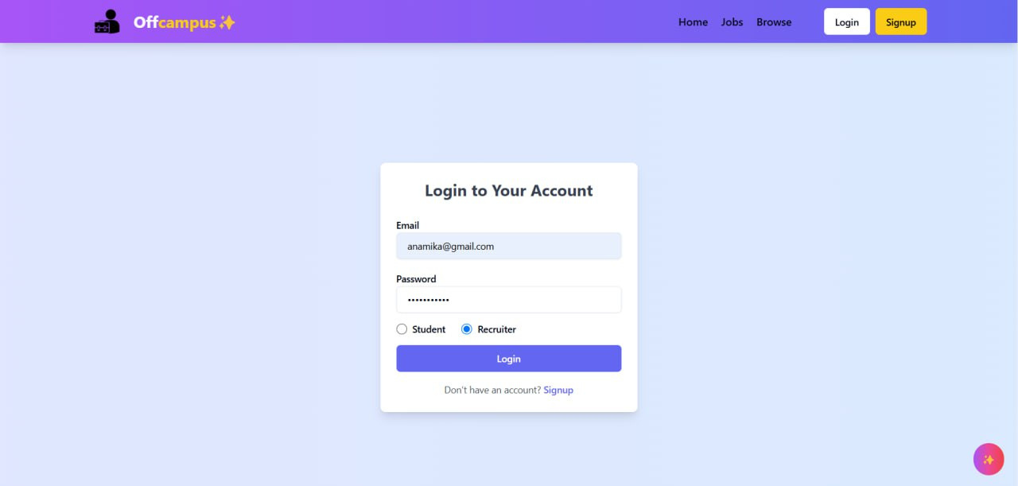
RECRUITER LOGIN
OffCampus
Page 11 of 22

Slide 17
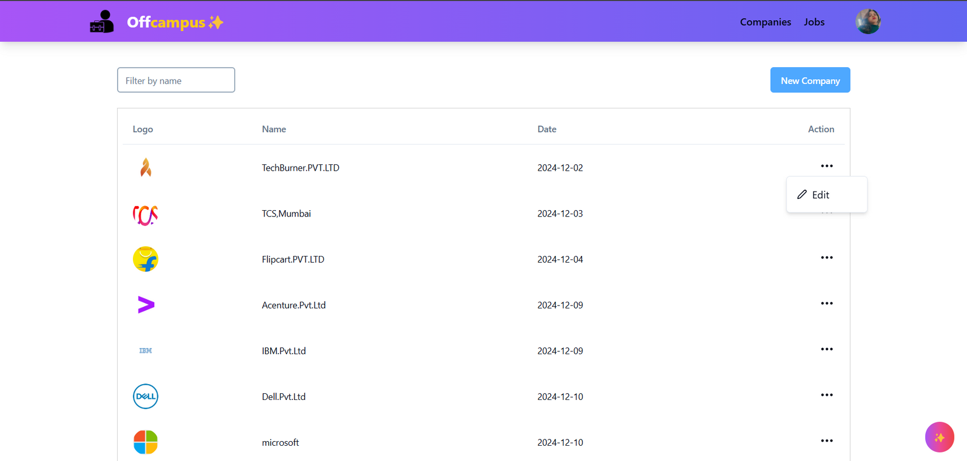
COMPANY LISTING TABLE
OffCampus
Page 12 of 22

Slide 18
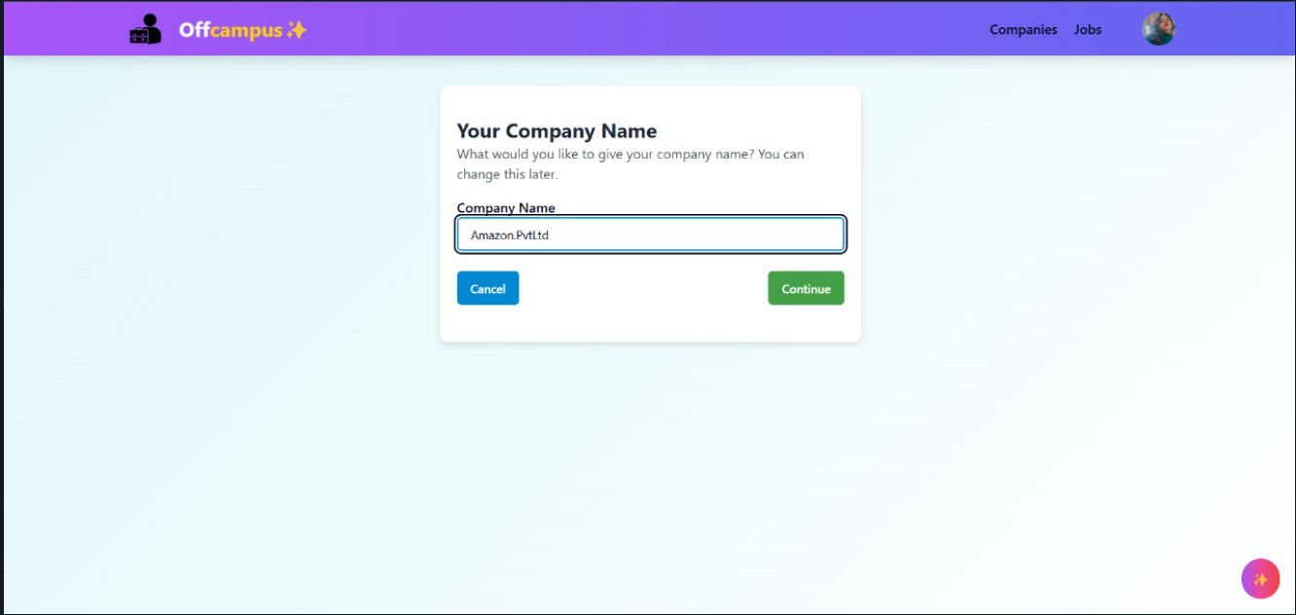
CREATE NEW COMPANY
OffCampus
Page 13 of 22

Slide 19
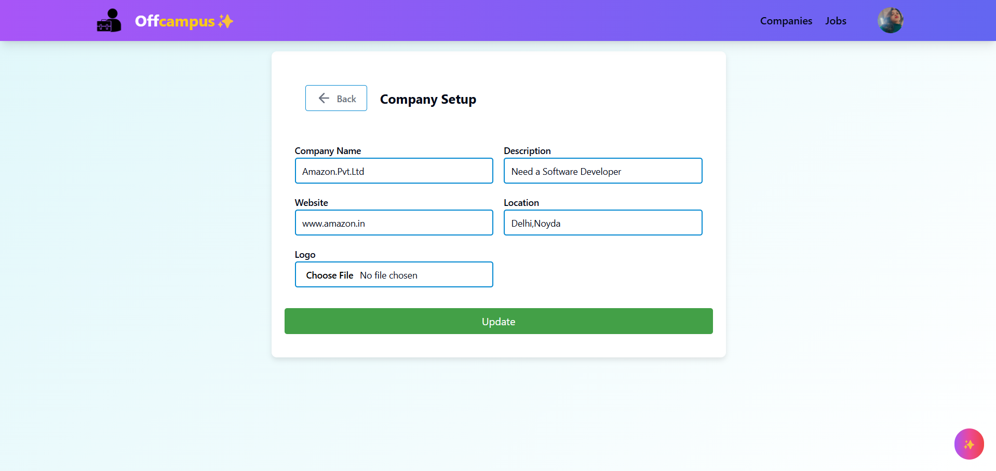
COMPANY SETUP
OffCampus
Page 14 of 22

Slide 20
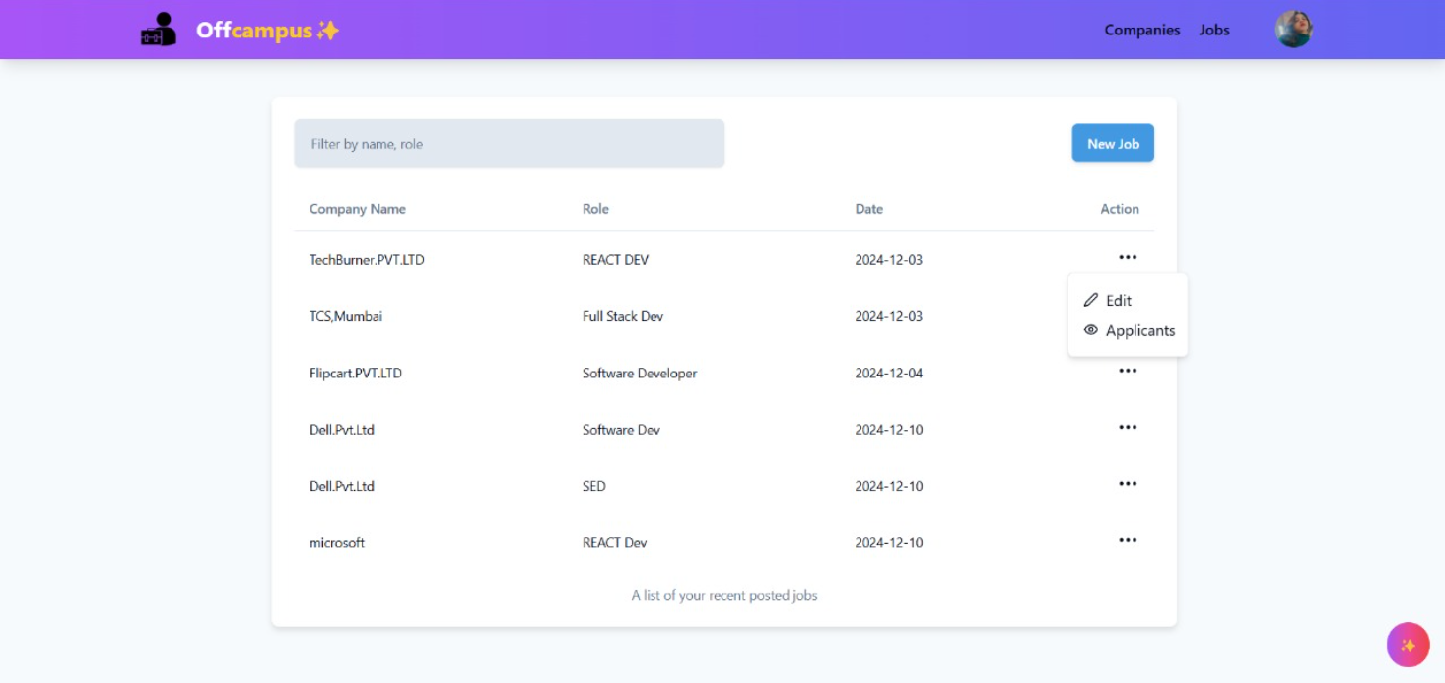
ALL JOB POSTED
Post can be edited and applicants can be viewed
OffCampus
Page 15 of 22

Slide 21
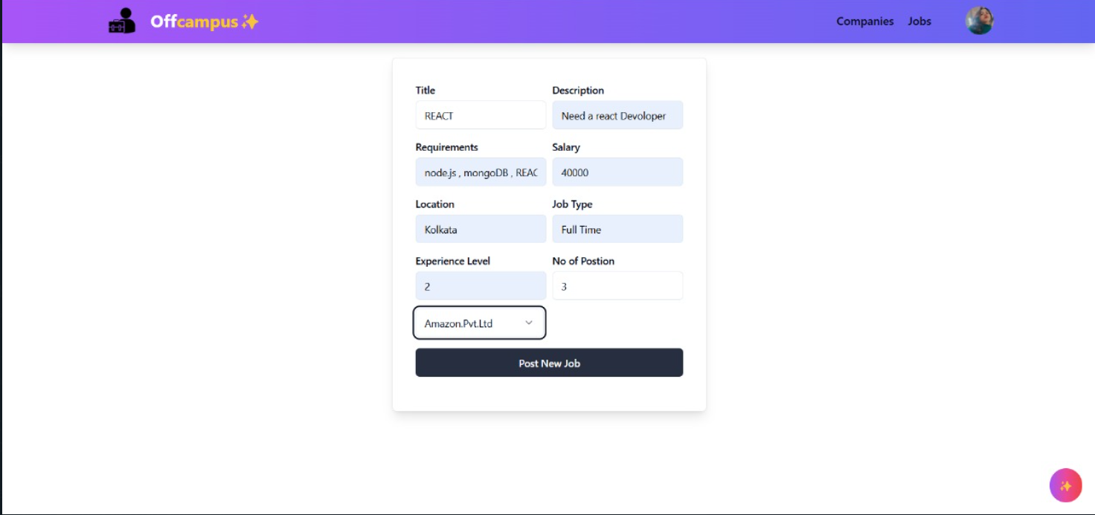
ADD DETAILS
OffCampus
Page 16 of 22

Slide 22
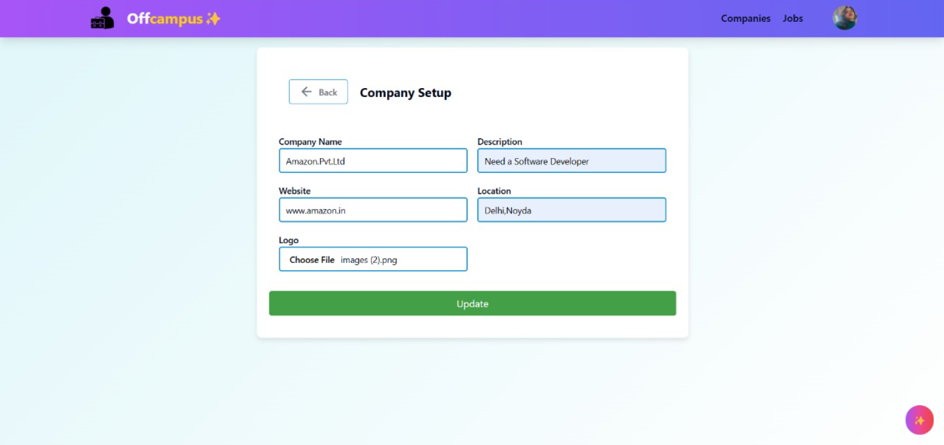
EDIT JOB POST
OffCampus
Page 17 of 22

Slide 23
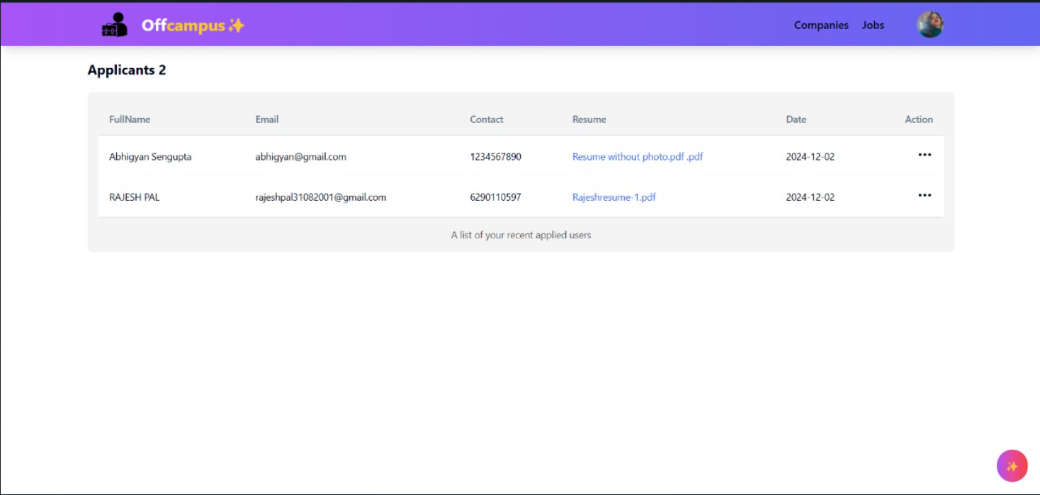
VIEW APPLICANTS
OffCampus
Page 18 of 22

Slide 24
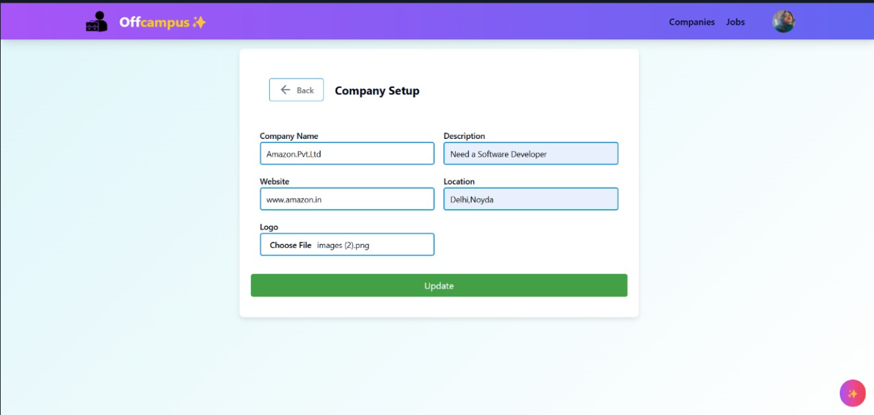
UPDATE JOB POST
OffCampus
Page 19 of 22

Slide 25
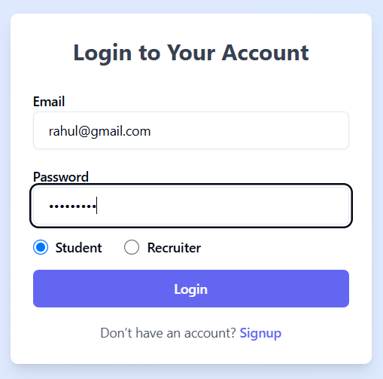
LOGIN AS STUDENT
OffCampus
Page 20 of 22

Slide 26
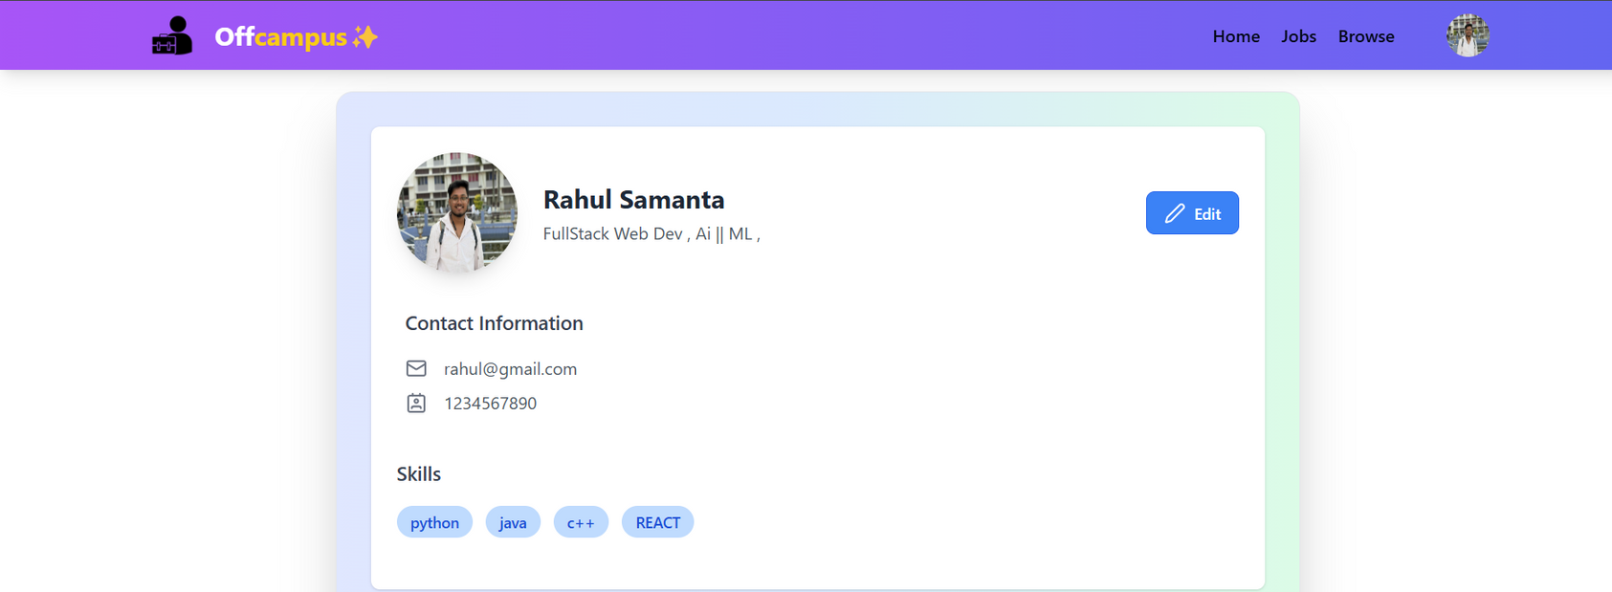
STUDENT PROFILE
Contact info, bio & skill section
OffCampus
Page 21 of 22

Slide 27
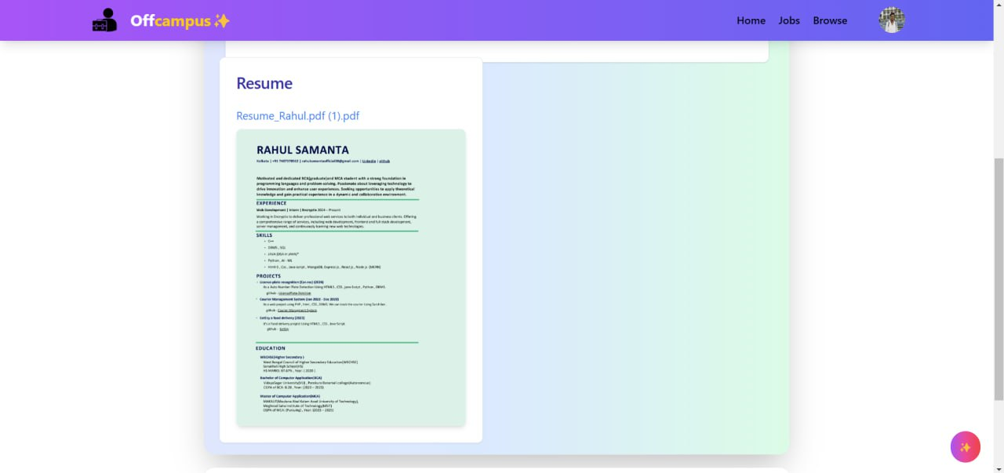
STUDENT PROFILE
Resume preview
OffCampus
Page 22 of 22

Slide 28
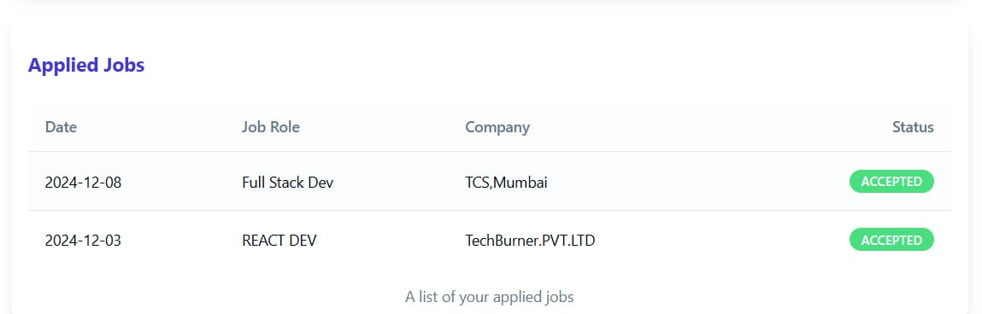
STUDENT PROFILE
Applied job table
OffCampus
Page 23 of 22

Slide 29

FUTURE SCOPE
Profile Grid Enhancement - Develop a visually appealing profile grid to showcase user profiles, making it easier to explore connections and opportunities.
Transition to a Off campus+ Browse to Social Media Platform -Evolve the website into a hybrid platform combining job search functionalities with social networking features.
Advanced Filtering System - Upgrade the filtering functionality to allow multiple filters to be applied simultaneously (e.g., location, job type, experience level).
Bookmark and Save Features - Expand the bookmarking system to allow users to organize saved jobs, profiles, or content into categories for better accessibility.
Mobile Application - Launch a mobile app for seamless accessibility, ensuring users can stay connected and updated on the go.
OffCampus
Page 07 of 07
OffCampus
Page 24 of 22

Slide 30
Conclusion
Our Job Portal System is designed to simplify and enhance the job search experience while fostering meaningful professional connections. By combining fast, user-friendly features with visually appealing animations and intricate design, the platform aims to provide an efficient and engaging experience for users.
With future advancements such as multi-filter searches, profile grids, social media integration, and AI-driven recommendations, the system is poised to evolve into a comprehensive career and networking hub. Our commitment to continuous improvement ensures that the platform will remain a valuable tool for job seekers and employers, bridging the gap between talent and opportunity.
OffCampus
Page 25 of 22

Slide 31




THANK
You
123-456-7890
@reallygreatsite
www.reallygreatsite.com
hello@reallygreatsite.com
OffCampus
Page 26 of 22

Slide 32

ANY
Questions?

